Slide 1
WIREFRAMING
PROTOTYPING
MOCKUPING

Slide 2
INTRODUCTION

Slide 3
Wireframes, prototypes and mockups are very common terms in UI/UX design.
What is wireframing, prototyping and mockuping? And what’s the difference between them?

Slide 4
WIREFRAMING

Slide 5
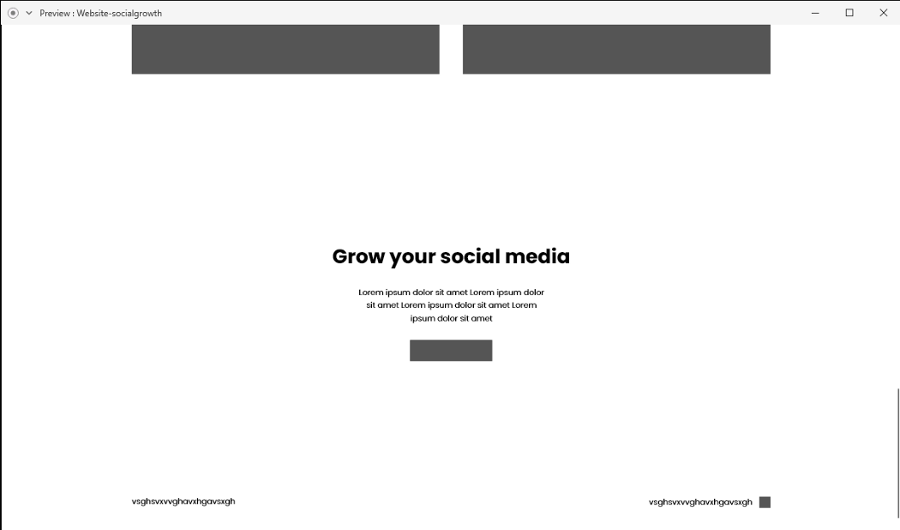
Definition
A wireframe is a low fidelity representation of a web page that shows the basic elements of the page. They are not interactive, and do not show much detail, but create a simple design that guides the project. Once it starts becoming interactive, it becomes a prototype.

Slide 6
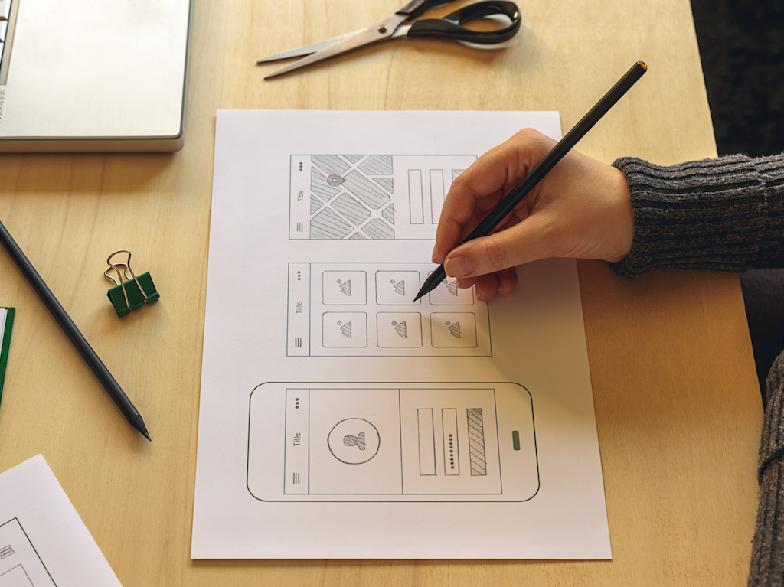
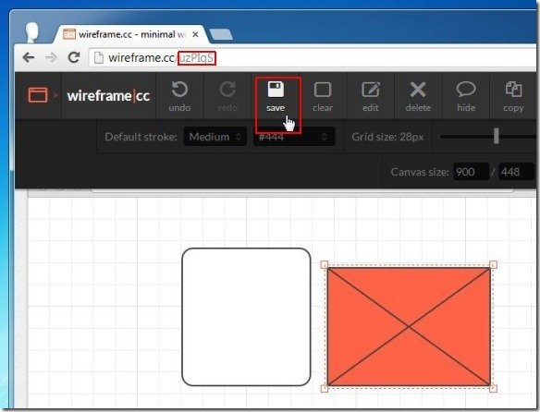
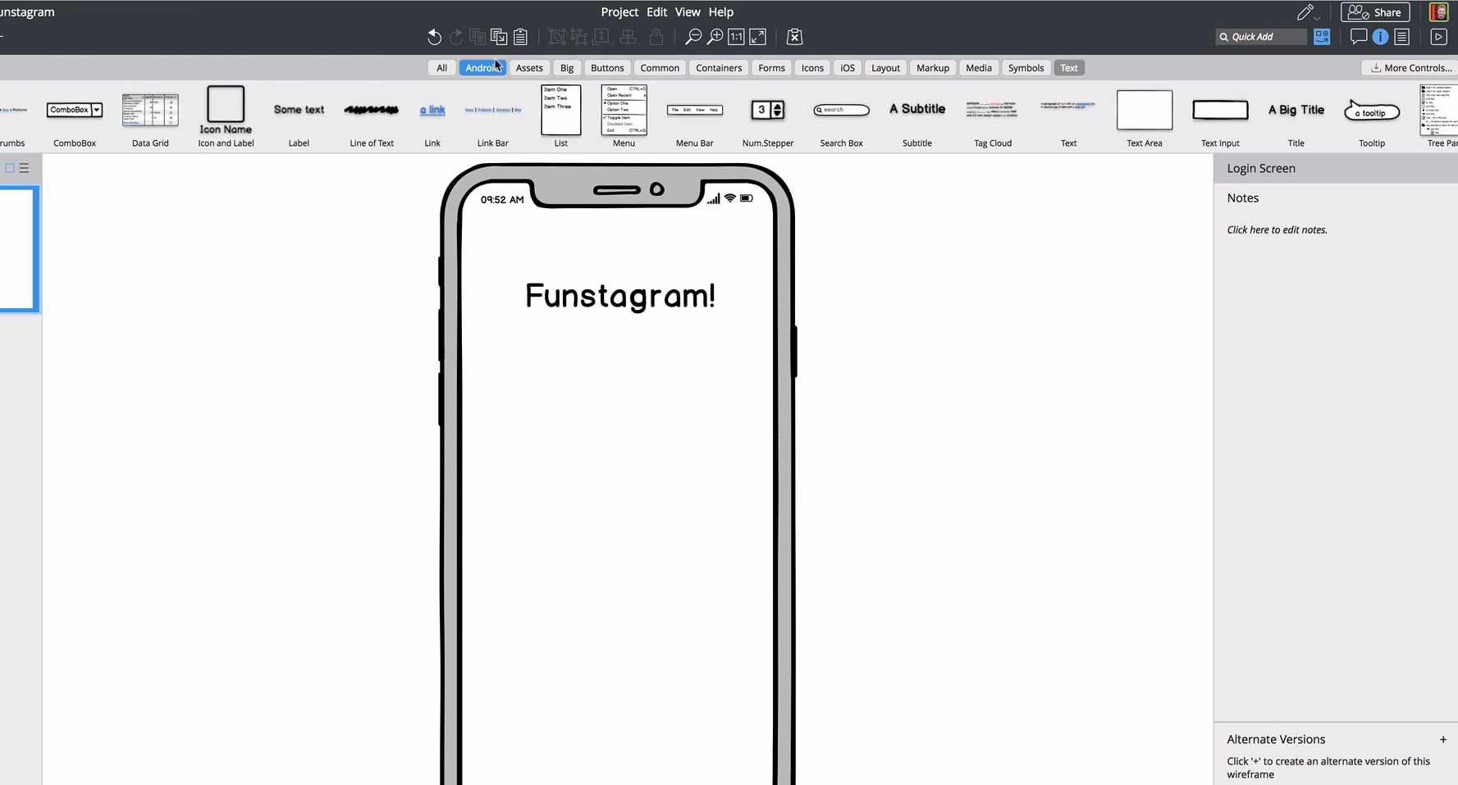
Tools
Pen and Paper : Putting your thoughts on a piece of paper can spark so many new ideas when you start digital design.
Balsamiq : is a rapid wireframing tool that reproduces the experience of whiteboarding but on the computer.
Wireframe.cc : is a very simple and minimal wireframing tool for websites and mobile apps.

Slide 7
Purposes
A wireframe is the blueprint of your website. The main purpose is to show the client how the website will look before designing.
Wireframes clarify and define website features.
Wireframes are quick and cheap to create.
It reduces a lots of work and time.

Slide 8
PROTOTYPING

Slide 9
Definition
A prototype is a more detailed interactive representation of the final product. Prototyping means building a model of the website before you build the actual website. Prototyping allows you to test the final product before spending time or money on code.

Slide 10
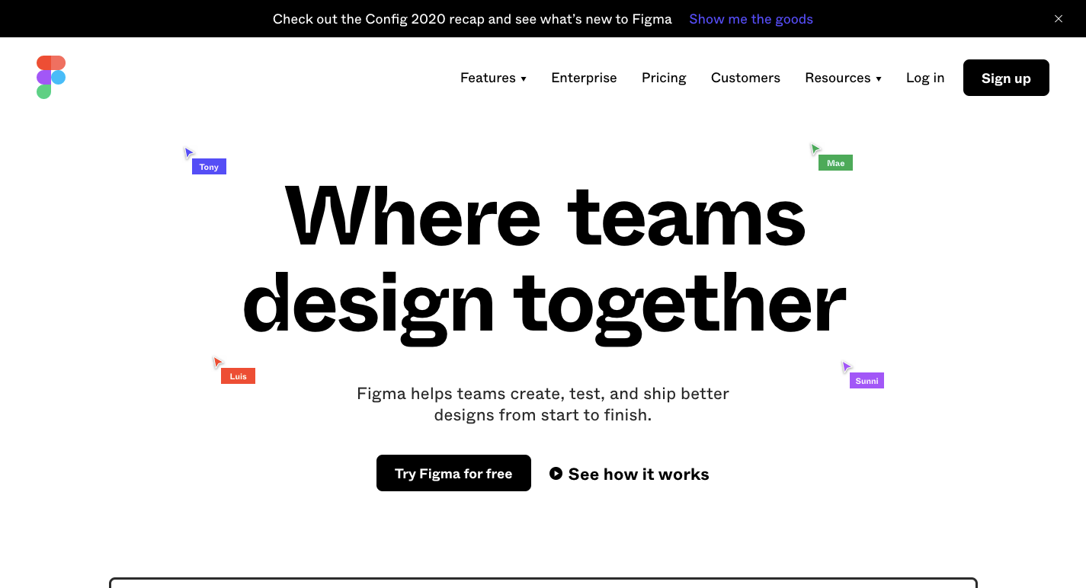
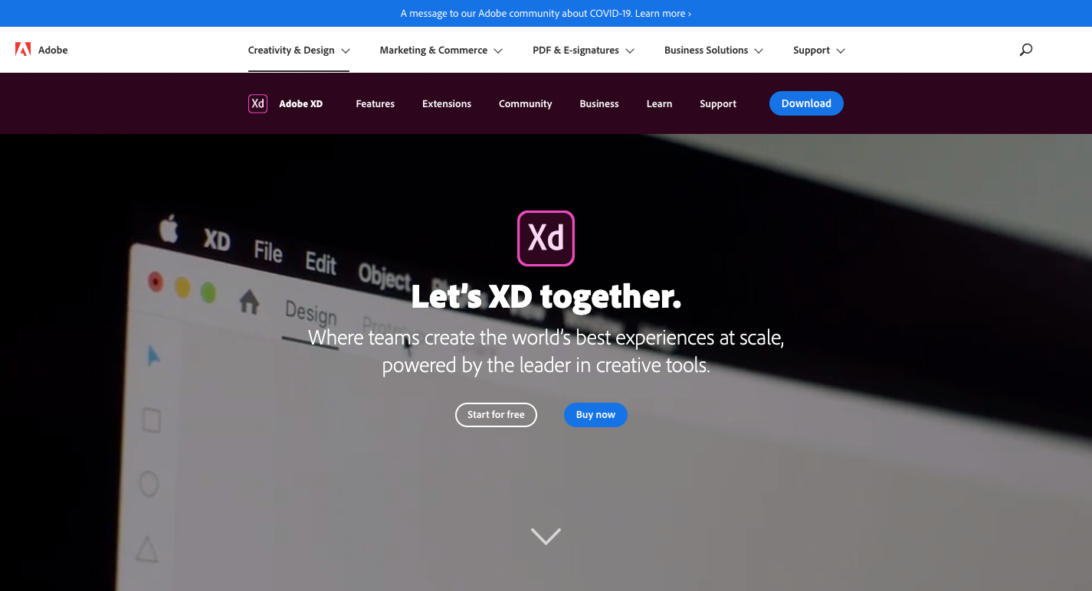
Tools
Figma : It is an all-in-one best prototyping tool. It makes the accessibility and collaboration for the designers and developers easier. It is a cloud-hosted platform.
Adobe XD : offers a vector-based system for putting together prototypes, including tools for creating interactions, transitions, and other types of dynamic functionality.

Slide 11
Purposes
Check whether it meets user's needs.
Test and find potential problems.
Find new design ideas.
Attract more clients.

Slide 12
MOCKUPING

Slide 13
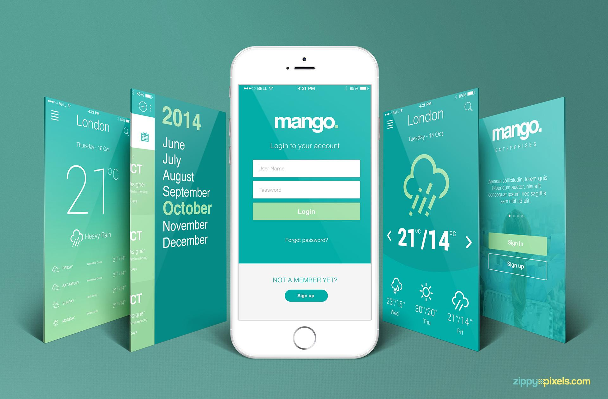
Definition
A mockup is a static high-fidelity design diagram that shows nearly all possible UI details and visuals. It is a nearly completed presentation of the final product, except that it does not have any interactions.

Slide 14
Tools
Artboard Studio : online graphic design application mainly focused on product mockups.
Moqups : helps you create and collaborate in real-time on wireframes, mockups, diagrams and prototypes.
Screenzy : instantly transform your pictures and screenshots into beautiful mockups ready to be shared on social media.

Slide 15
Purposes
Represents the structure of information.
Visualises the content and demonstrates the basic functionalities in a static way.
Encourages people to actually review the visual side of the project.
No mockup – no HTML coding
No mockup – no users

Slide 16
CONCLUSION

Slide 17
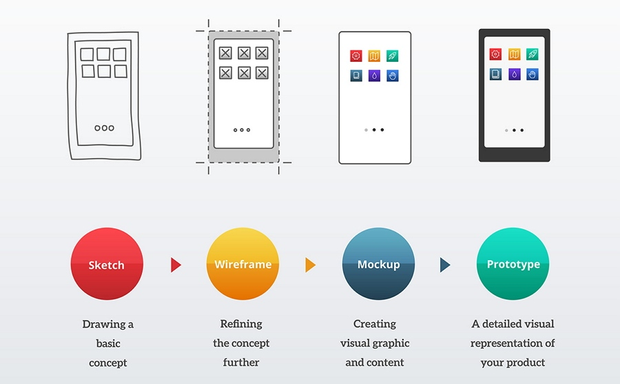
A wireframe, mockup, and prototype are models with different UI details and visuals. They are used at different stages of web and mobile app design for designers to better communicate and collaborate with other designers, developers, and other team members.

